Slide 1
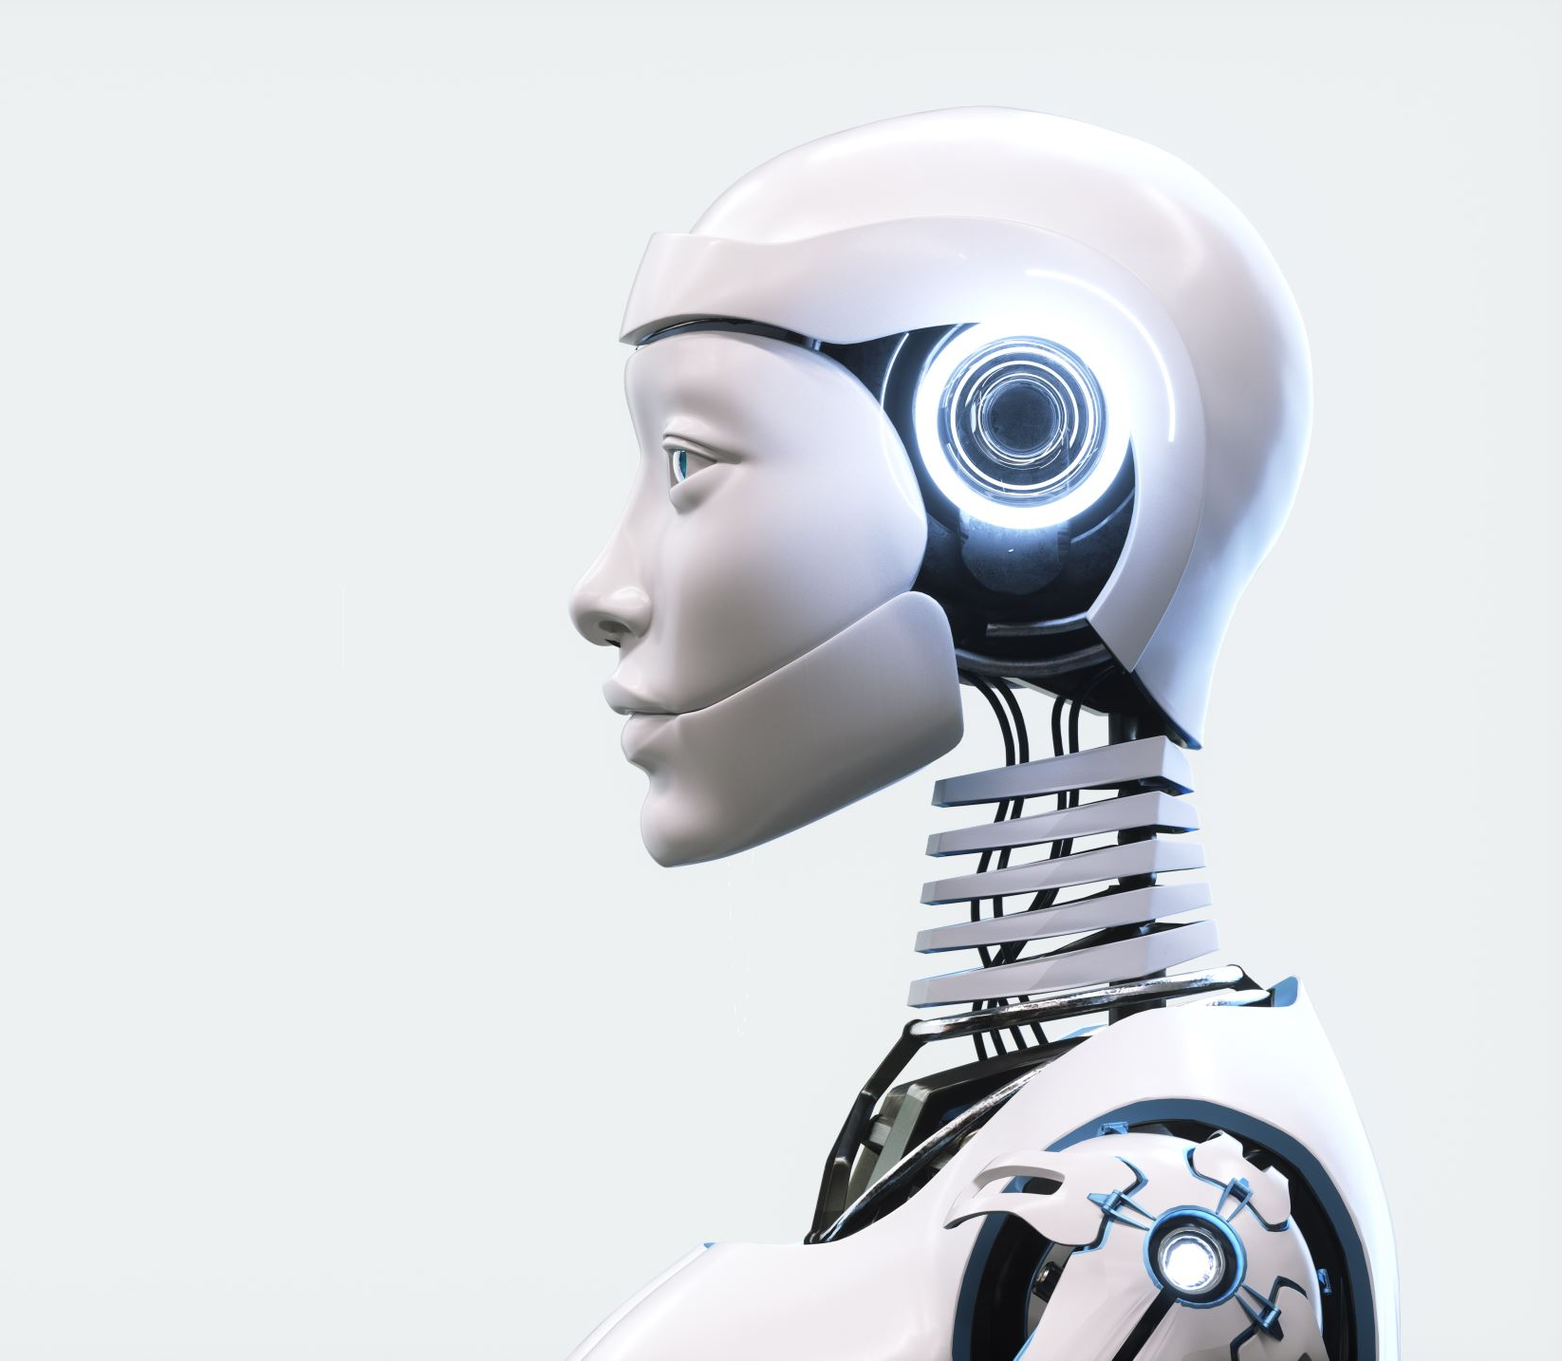
automation and ai
the open discussion

Slide 2

agenda
Introduction
Types of Automation
Benefits of Automation
AI in the Workplace
Skill Acquisition Marathon
Food for Thoughts & Wrap-up

Slide 3

introduction
Automation is the deliberate use of technology to perform tasks with minimal human intervention, well sometimes it can be no human intervention at all.
This involves the use of software and machines to execute repetitive, mundane, time-consuming, and literally boring tasks.
It can range from rule-based to something complex and leveraging AI.

Slide 4
types of automation
Script-based Automation
Robotic Process Automation
AI-driven Automation

Slide 5

script-based automation
This involves writing code to automate specific tasks or workflows mimicking anything that is more or less a human behavior.
We can use any language but the generally used one is Python
So when using Python we can get some libraries that enable you to do tasks like web scraping such as scrapy, selenium, etc.
One use case of this is what we are currently working on in Thola.

Slide 6
rpa
RPA uses software robots to mimic human actions and automate rule-based tasks across various applications and systems. UiPath
Rule-based Automations.
Examples are.
Processing invoices and spreadsheets while handling accounts payables in a financial setting
Extracting and processing data from emails and documents

Slide 7
ai-driven automation
This case leverages the power of ai and machine learning to perform complex task that require decision making and adaptability
This kind of automation is the one that seems to work in situations that are dynamic and prone to uncertainty
Ai improves over time so as the whole preciseness of the situation
Example;
using natural language processing for automating customer interaction through chatbots.

Slide 8

benefits of automation
Enhances productivity and efficiency
Enhanced accuracy
Improved decision making
Innovation and creativity
Cost saving
Improved satisfaction
Competitive advantage

Slide 9
ai in the workplace
It is evident that everyone is involved in the controversial issue of job disruption
Tech companies specializing in AI feel like it will take some time before ai replace people
The need for human touch still exists.

Slide 10

skills acquisition marathon
How do you stay relevant in the workplace?
At the same time as you do your work, how do you get new skills?
To which direction should you go?
Leverage automation for continuous learning so that you can stay relevant in the workplace!

Slide 11
food for thoughts and wrap-up
Ethical considerations of AI and automation in the workplace.
Constant Redefinition of Job Roles.
AI Human Collaboration.
Societal Impactful Use Case of Automation and AI

Slide 12

Thank you!

